Slide 1
Unsupervised Learning Capstone
Walmart Sales Data

Slide 2
Aim:
To analyze the sales data of M-5 Walmart.
To preprocess the sales data using Dimension Reduction by preserving 95% of the variance.
To apply Unsupervised Learning’s Clustering algorithms to the data.
To forecast the sales as a part of Kaggle’s competition.

Slide 3
Data:
We will be applying the unsupervised algorithms to the Selling Price Validation dataset.
It contains the sales data from day 1 to day 1913, Store ID, State ID, Item ID, Department ID, Category ID.
The shape of the data is 30,490 Observations and 1919 Features.

Slide 4
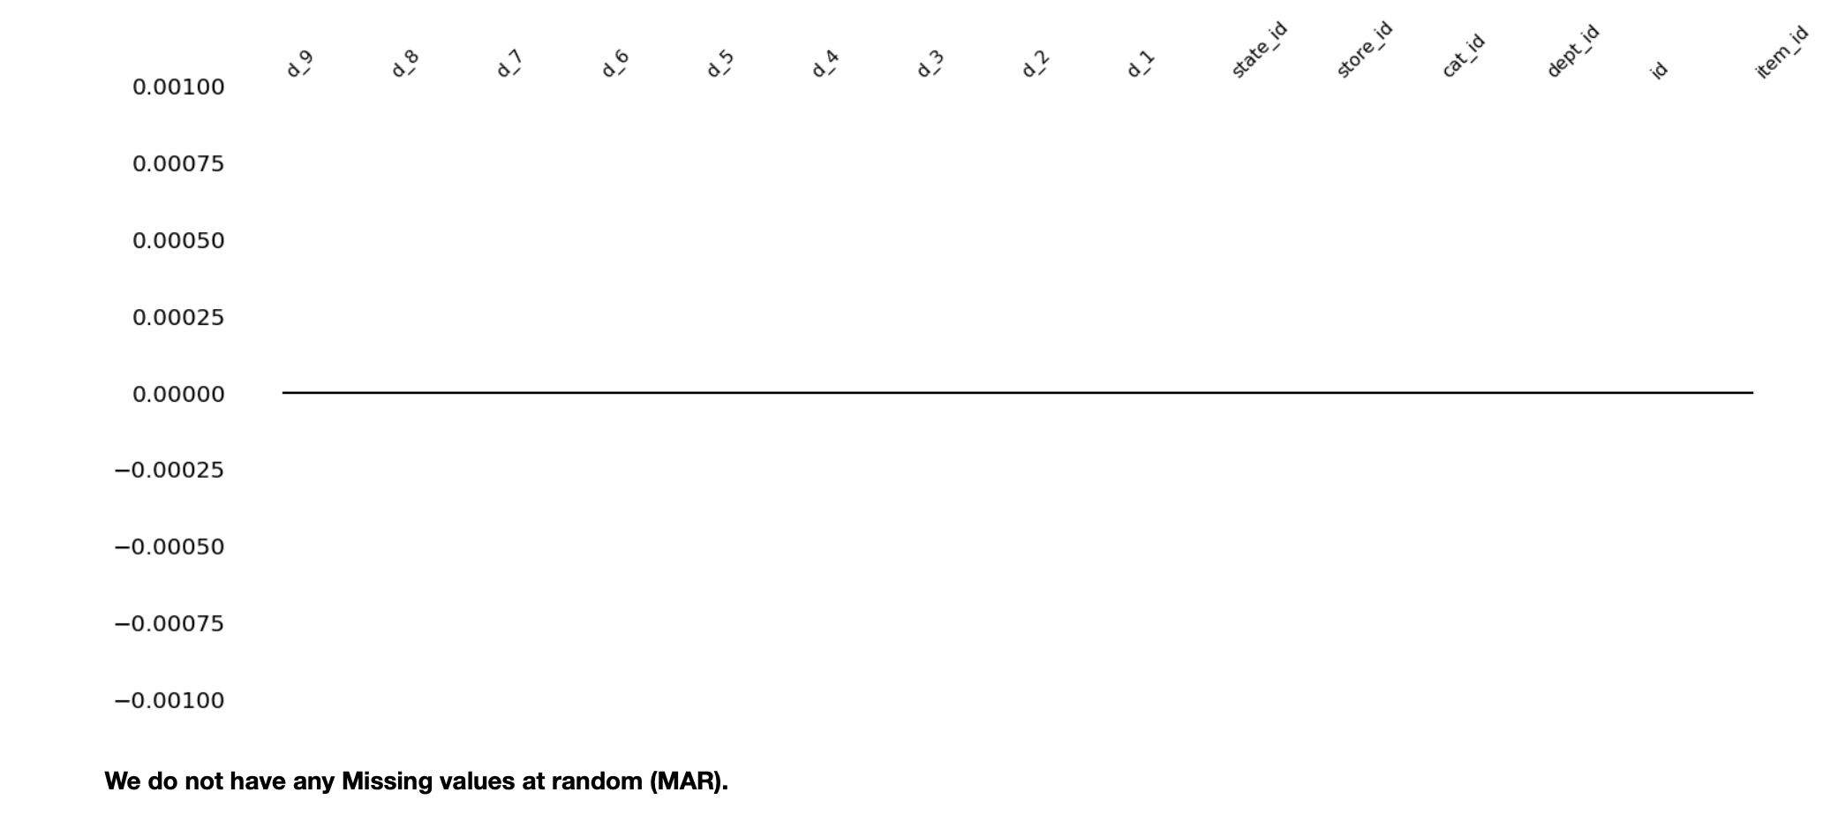
Exploring Data
Since the data is too big, the data has been subsetted to 15 columns.
Checked for MAR and found 0 missing values.

Slide 5
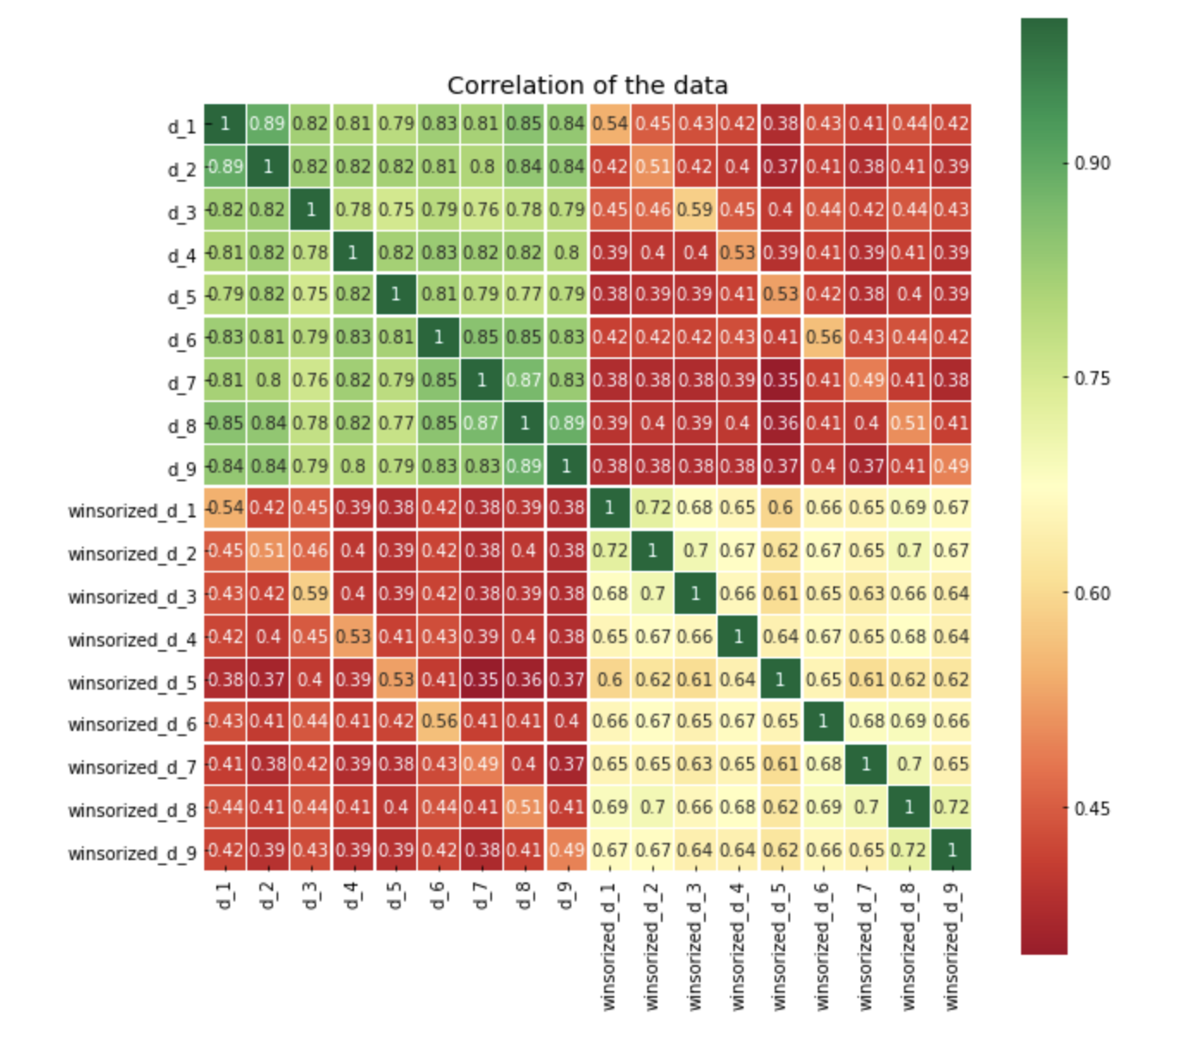
Heatmap
The heat map was plotted between winsorized and the normal days.
We can see few of the sales data like d_3 and d_8 are highly correlated.

